Slide 1
Key Stage 4 Evening
For our 2018 exam results, 100% of students achieved at least one qualification. 53% of students gained both English and Mathematics at GCSE grade 4 or above. 29 % of students gained both English and Mathematics at GCSE grade 9-5. 68% of all GCSE entries were graded at 4 or above.
17% of all GCSE grades were grade 7 or above, with some students gaining the highest grade 9. The Sixth Form has shown year on year improvement.
The average grade achieved was in the Sixth Form is now a B and this is above the national average, with 25% of our students achieving an A*/A at A-level. This shows how truly inclusive and comprehensive we are as a school.
The College’s headline measure of Attainment 8 is 44 and Progress 8 was -0.16. This is a new national headline measure of the best 8 subjects including English and Mathematics.

Slide 2
Welcome
Aims of the Evening.
Explain the Key Stage 4 curriculum and the options process.

Slide 3

Key Stage 4 Curriculum
Aims of Key Stage 4
To provide a broad, balanced curriculum for our students
To ensure students study a curriculum that allows for appropriate progression routes to post 16 provision

Slide 4
Key stage 4
What is the difference?
students study subjects in more depth
they must choose some and stop studying others
not everyone will study the same thing
students will work towards a qualification

Slide 5
The college aims to ensure that all students leave with a qualification
  GCSE
  Technical Award
  Key Skill
The college aims to ensure that all students are still educated in life skills, moral, spiritual & cultural aspects of life.

Slide 6
Progression routes
A Level courses
Further education
GCSE courses
Level 3 Technical courses
Higher education
CONSIDER
OPTIONS
CONSIDER
OPTIONS
Foundation (Level 2)
CONSIDER
OPTIONS
Apprenticeship post 18
14
Technical courses
16
18
Apprenticeship
Employment
Employment with Training
Employment with training
Key Stage 4
Key Stage 5

Slide 7
Key Stage 4 Curriculum
GCSE English Language
GCSE English Literature
GCSE Mathematics
GCSE Science (Double Science or Separate Sciences)
GCSE Religious Studies
Core PE
Compulsory Subjects
EBacc Subject
GCSE French
GCSE Geography
GCSE German
GCSE History
Additional Choices
Selection from 16 GCSE and Technical subjects

Slide 8
Key Stage 4 Curriculum
GCSE English Language
GCSE English Literature
GCSE Mathematics
GCSE Science (Double Science or Separate Sciences)
GCSE Religious Studies
Core PE
Compulsory Subjects
E Bacc Subject
GCSE French
GCSE Geography
GCSE German
GCSE History
Additional Choices
Selection from 16 GCSE and Technical subjects

Slide 9



Which subjects are compulsory?
All students will study
GCSE English Language
GCSE English Literature
GCSE Mathematics
GCSE Science (Double Science or Separate Sciences)
GCSE Religious Studies
Core PE

Slide 10
Key Stage 4 Curriculum
GCSE English Language
GCSE English Literature
GCSE Mathematics
GCSE Science (Double Science or Separate Sciences)
GCSE Religious Studies
Core PE
Compulsory Subjects
E Bacc Subject
GCSE French
GCSE Geography
GCSE German
GCSE History
Additional Choices
Selection from 16 GCSE and Technical subjects

Slide 11




What are the EBacc subjects?
Choose one from the following EBacc subjects:-
French
Geography
German
History
Ensuring a broad and balanced curriculum

Slide 12
Key Stage 4 Curriculum
GCSE English Language
GCSE English Literature
GCSE Mathematics
GCSE Science (Double Science or Separate Sciences)
GCSE Religious Studies
Core PE
Compulsory Subjects
E Bacc Subject
GCSE French
GCSE Geography
GCSE German
GCSE History
Additional Choices
Selection from 16 GCSE and Technical subjects

Slide 13
What are the additional choices?
Students select two from:-
Art and Design (GCSE)
Business (BTEC L1/2)
Computer Science (GCSE)
Design Technology (GCSE)
French (GCSE)
Geography (GCSE)
German (GCSE)
Health and Social (BTEC L1/2)
History (GCSE)
Hospitality and Catering (Eduqas L1/2)
ICT/Media (OCR L1/2)
Music (GCSE)
Performing Arts (Acting) (BTEC L1/2)
Performing Arts (Dance) (BTEC L1/2)
Sport (BTEC L1/2)
Psychology (GCSE)

Slide 14
What are the additional choices?
Students select two from:-
Ebacc
French (GCSE)
Geography (GCSE)
German (GCSE)
History (GCSE)
Vocational
Business (BTEC L1/2)
Health and Social (BTEC L1/2)
Hospitality and Catering (Eduqas L1/2)
ICT/Media (OCR L1/2)
Performing Arts (Acting) (BTEC L1/2)
Performing Arts (Dance) (BTEC L1/2)
Sport (BTEC L1/2)
GCSE
Art and Design (GCSE)
Computer Science (GCSE)
Design Technology (GCSE)
Music (GCSE)
Psychology (GCSE)

Slide 15
What are the additional choices?
Why do the vocational courses have different names?
Students select two from:-
Ebacc
French (GCSE)
Geography (GCSE)
German (GCSE)
History (GCSE)
Vocational
Business (BTEC L1/2)
Health and Social (BTEC L1/2)
Hospitality and Catering (Eduqas L1/2)
ICT/Media (OCR L1/2)
Performing Arts (Acting) (BTEC L1/2)
Performing Arts (Dance) (BTEC L1/2)
Sport (BTEC L1/2)
Because unlike GCSEs each exam board has a different name for their course. The most well known “BTec” is a brand name for Pearson (formerly Edexcel)
GCSE
Art and Design (GCSE)
Computer Science (GCSE)
Design Technology (GCSE)
Music (GCSE)
Psychology (GCSE)

Slide 16
The Curriculum
English
Maths
RS
Science/PE
Option 1
English
Maths
Science/PE
Option 1
English
Maths
Science/PE
Option 1
English
Maths
Science/PE
Option 2
Science/PE
Option 2
Science/PE
Option 2
Science/PE
Option 3
Option 3
Option 3
2 GCSE
1 or 2 GCSE
1 GCSE
2 or 3 GCSE
1 to 3 GCSE
1 or 2 Btec

Slide 17
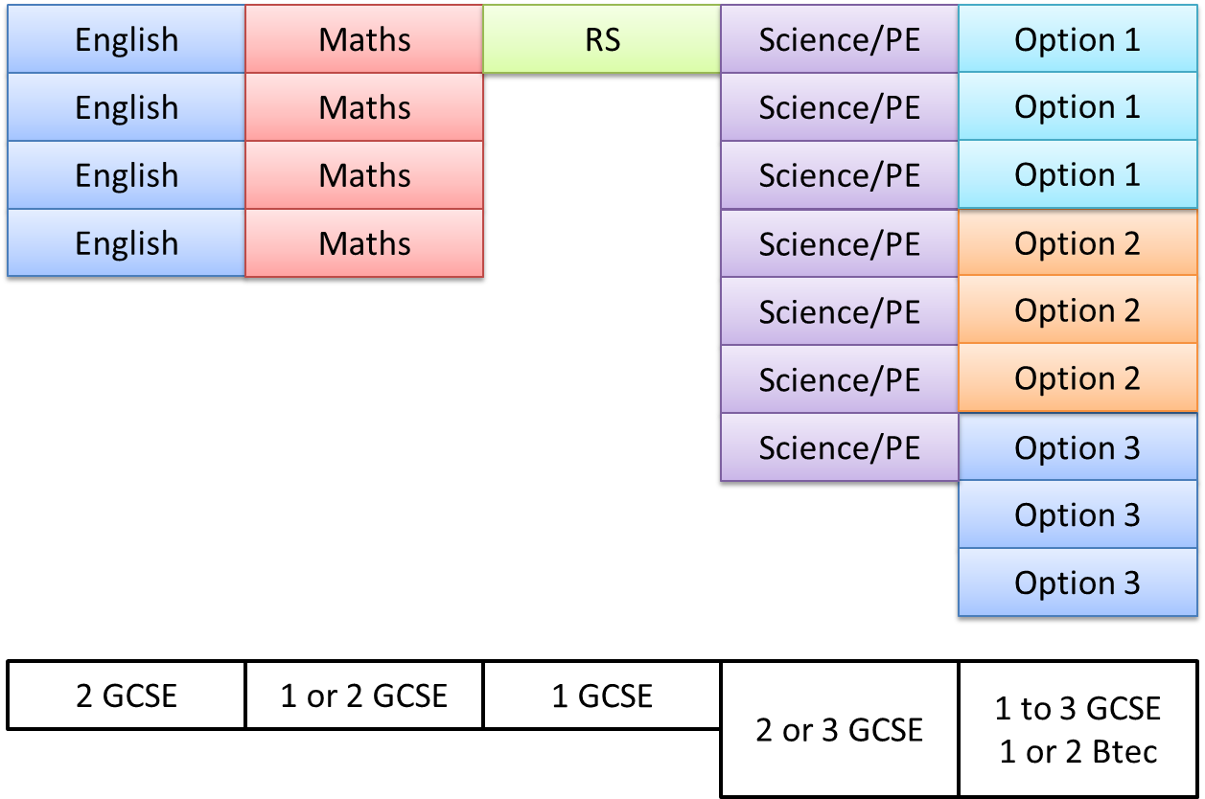
The Curriculum

Slide 18
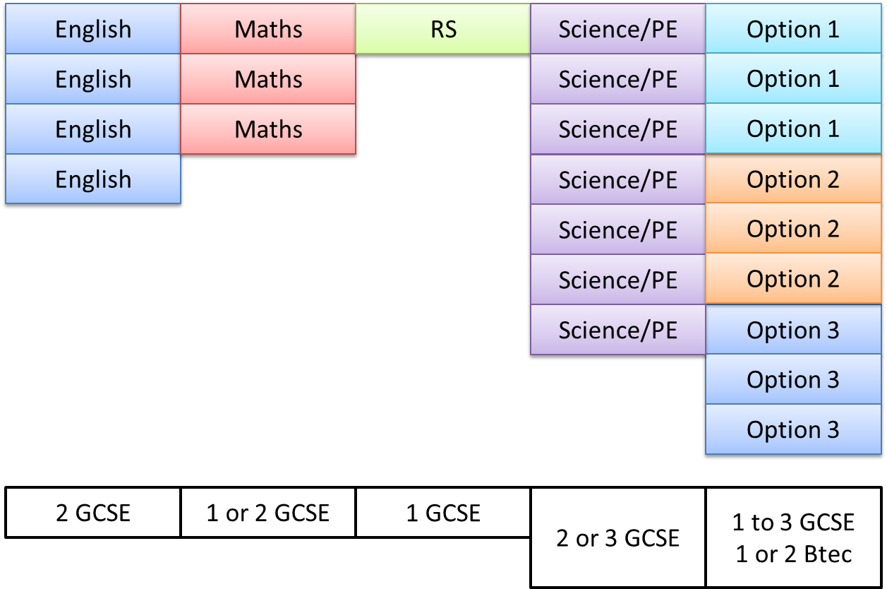
Science
Chemistry
Combined Science
Chemistry
Combined Science
Physics
Combined Science
Physics
Combined Science
Biology
Combined Science
Biology
P.E
P.E
P.E
2 groups
4 groups
3 GCSE
2 GCSE

Slide 19



What should students consider?
Career Does it lead to a job?

Slide 20

What should students consider?
Career Does it lead to a job?
Interests Do they enjoy it?

Slide 21

What should students consider?
Career Does it lead to a job?
Interests Do they enjoy it?
Ability Are they good at it?

Slide 22

What should students consider?
Career Does it lead to a job?
Interests Do they enjoy it?
Ability Are they good at it?
Pathways Where can they go next?

Slide 23

What should students consider?
Career Does it lead to a job?
Interests Do they enjoy it?
Ability Are they good at it?
Pathways Where can they go next?
Learning styles Does it suit the way they learn?

Slide 24
What examinations will my child sit?
Courses
GCSE
Technical
Awards

Slide 25
What examinations will my child sit?
GCSE
Examination (most 100%)
Rare Controlled Assessment
Grading (9 - 1)
Higher level (9 - 4)
Foundation level (5 – 1)
Not Common any more.

Slide 26
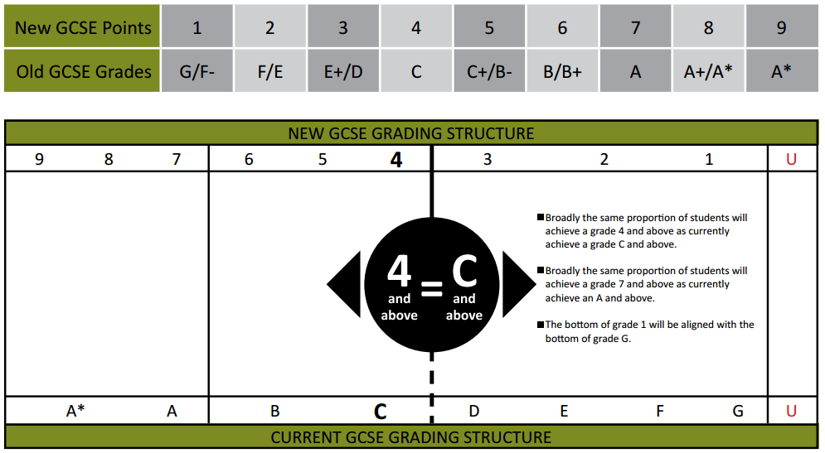
New Grading System

Slide 27
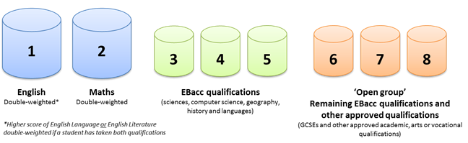
Attainment 8
Attainment 8 is a measure of a pupil’s average grade across a set suite of eight subjects.
Grades will be measured on a 1-8 point score scale, rather than the current 16-58 scale.
On this new scale, 1 is equivalent to a Grade G GCSE. An increase in one point will represent an increase of one GCSE grade up to 8, which is equivalent to an A* GCSE.
Notes:
AFL is…

Slide 28
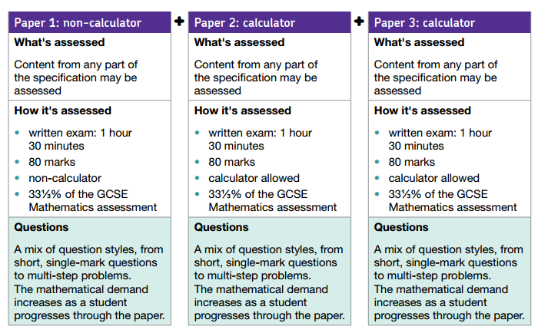
Maths

Slide 29
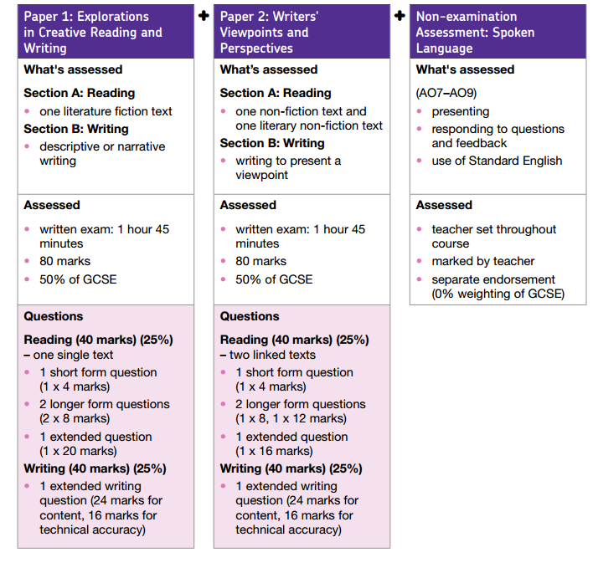
English

Slide 30
What examinations will my child sit?
Technical Awards
Examination/Controlled assessment (25%*)
Coursework
Level 2
Distinction*=8.5
Distinction =7
Merit = 5.5
Pass = 4
Level 1
Distinction = 3
Merit = 2
Pass =1.75
Source https://assets.publishing.service.gov.uk/government/uploads/system/uploads/attachment_data/file/783865/Secondary_accountability_measures_guidance.pdf
All Technical Awards are the equivalent of one GCSE
*can vary

Slide 31
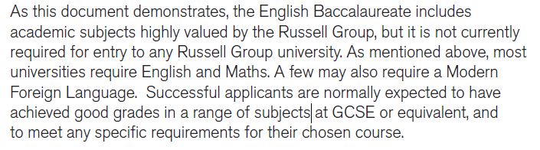
Extract from “Informed choices”
Produced by the Russell group of Universities
Click to view the Document.

Slide 32
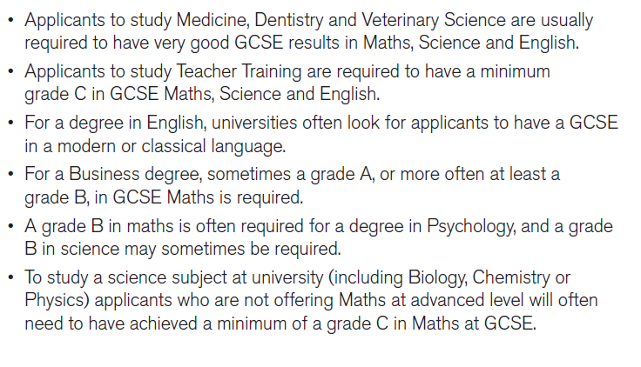
Extract from “Informed choices”
Produced by the Russell group of Universities
Click to view the Document.

Slide 33
Choosing the Full English Baccalaureate (EBacc)
E Bacc Option – Select one, a OR
Additional Choices – Select a OR
Additional Choices – Select any other subject
The English Baccalaureate (EBacc) is a school performance measure. It allows people to see how many pupils get a grade C or above in the core academic subjects at key stage 4 in any government-funded school.
Humanities
Language
Humanities
Language

Slide 34
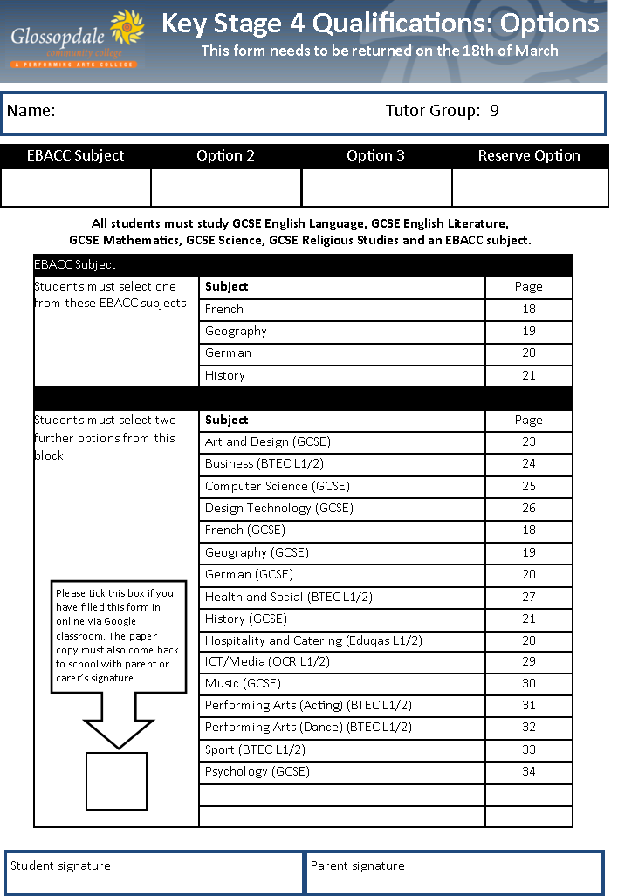
Jonny Smith
DBT
History
French
ART
Catering

Slide 35
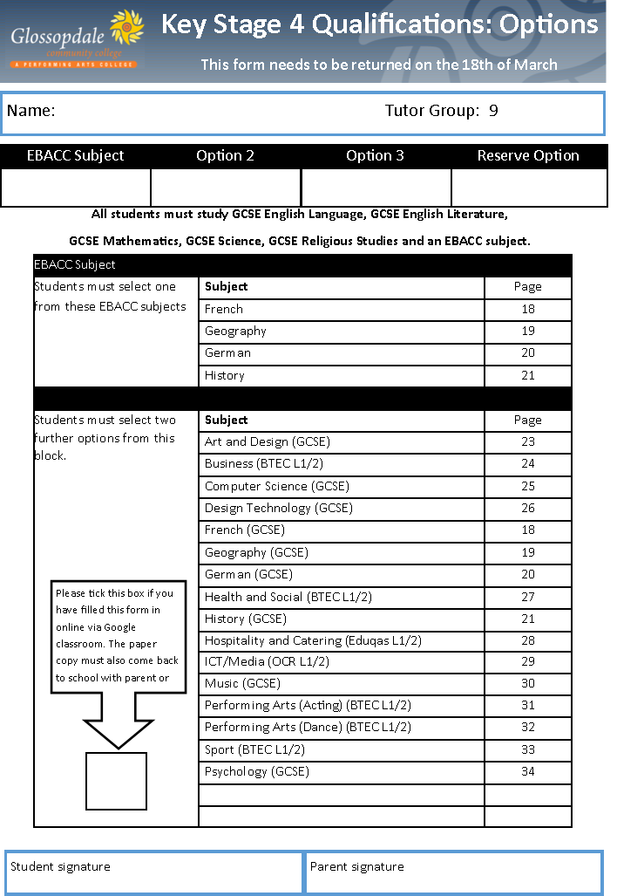


Slide 36
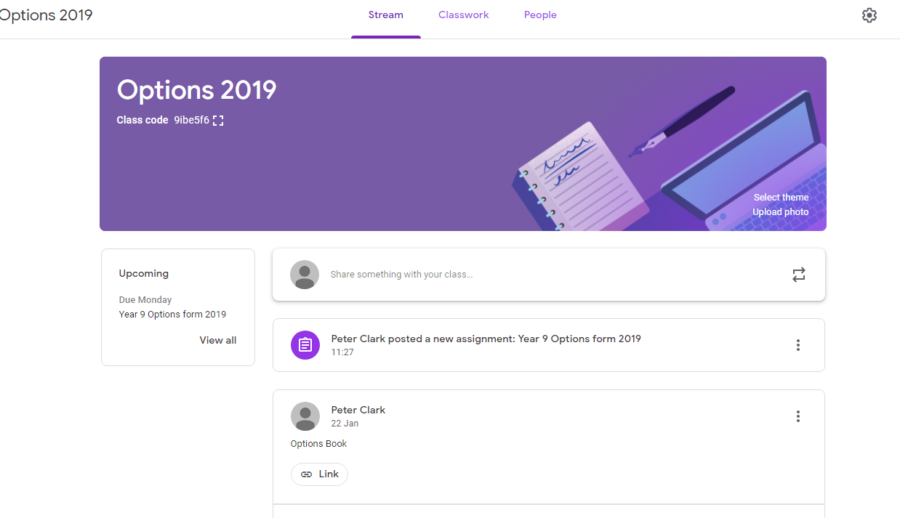

Slide 37
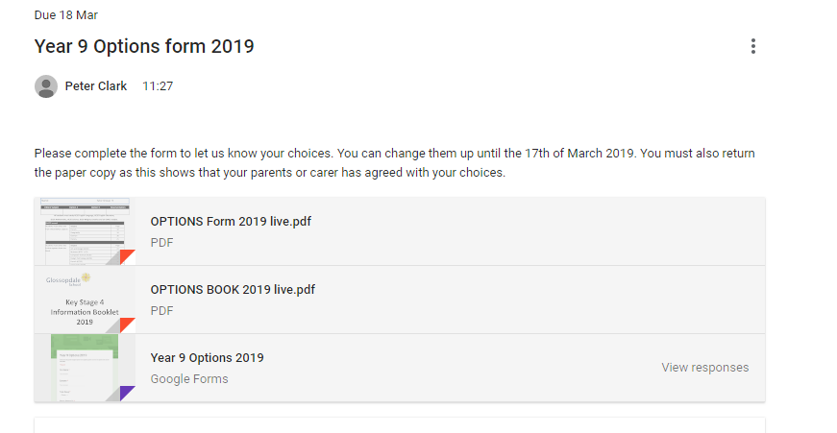

Slide 38
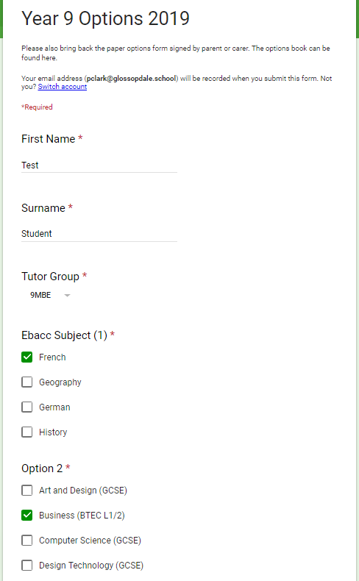

Slide 39
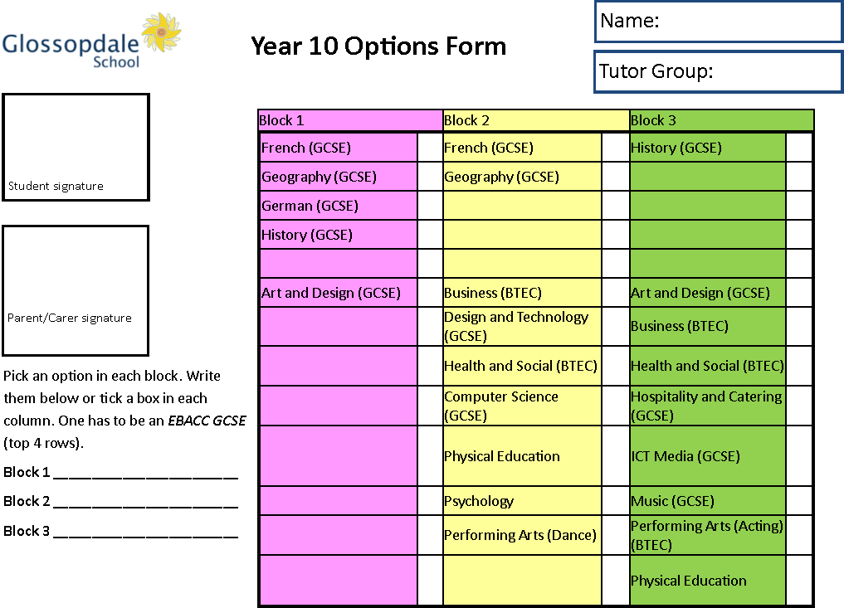

Slide 40
Where to get advice
Subject teacher
Form tutor
Careers service
Personal interview
Options Booklet
Year Manager

Slide 41
week | Week Beginning | Monday | Tuesday | Wednesday | Thursday | Friday
21 | 21/1/19 |  |  | Launch of Options in assembly
22 | 28/01/19 | Complete Super Learning Day Taster Sessions forms in tutor time IT rooms.
23 | 04/02/19 |  |  |  | KS4 Booklet online.
 |  | Information, Advice and Guidance work through Personal Develop Programme in tutor time
24 | 11/02/19 |  | Y9 Super Learning Day. Taster sessions for Options subjects.
 |  | Information, Advice and Guidance work through Personal Develop Programme in tutor time
25 | 18/02/19 | Half Term | Half Term | Half Term | Half Term | Half Term
26 | 25/02/19 | Options Advice Clinic in Progress Office in LRC at lunchtimes this week Tutor time IAG work
27 | 04/03/19
28 | 11/03/19 |  |  |  | KS4 Option Evening 5:30– 7:00 | KS4 Option Forms given out
29 | 18/03/19 | KS4 Option Forms Returned
30 | 25/03/19 | Discussions with students about choices
31 | 01/04/19 | Choices Finalised

Slide 42
(23-1-19) Options Launch Assembly
Next week – Tutor Programme (Computers – careers and options form)
14-2-19 Options booklet online (probably before)
12-2-19 Options Super Learning Day
14-3-19 Options Evening for Students and Parents/Carers
15-3-19 Options form to take home (assembly Fri 2:10)
18-3-19 Options form handed in to tutors or Student Reception

Slide 43
In the future
There will be a Key Stage 4 information evening which will focus on the courses and key skills needed.
There will be presentations from the English, Mathematics and Science faculties.
Last year’s presentation is here… http://www.glossopdale.derbyshire.sch.uk/docs/Year_10_Parents_Information_Evening_September_2018_final_12-9-18.pptx

Slide 44
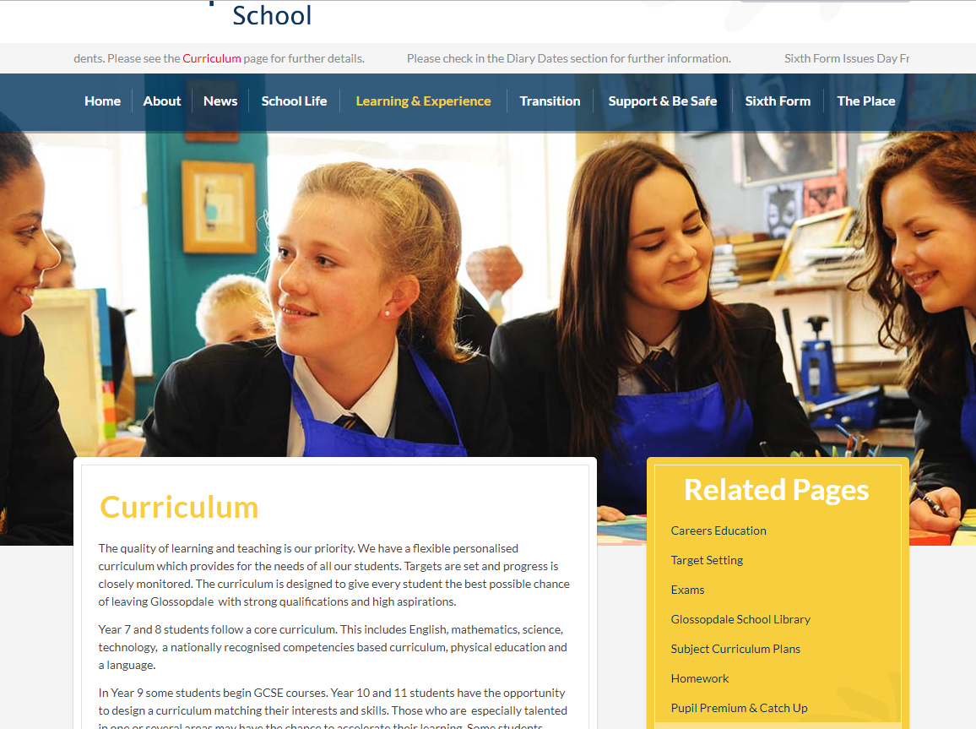
Website
http://www.glossopdale.derbyshire.sch.uk/Curriculum/

Slide 45
